Slide 1
Uses of transcriptome sequencing
Transcript assembly
  Can help figure out which genome sequences are transcribed, locate exons/introns
  Use transcripts for genome annotation
Transcript quantification
  Figure out which transcripts are expressed
  Could be very different in different tissues, under different conditions

Slide 2
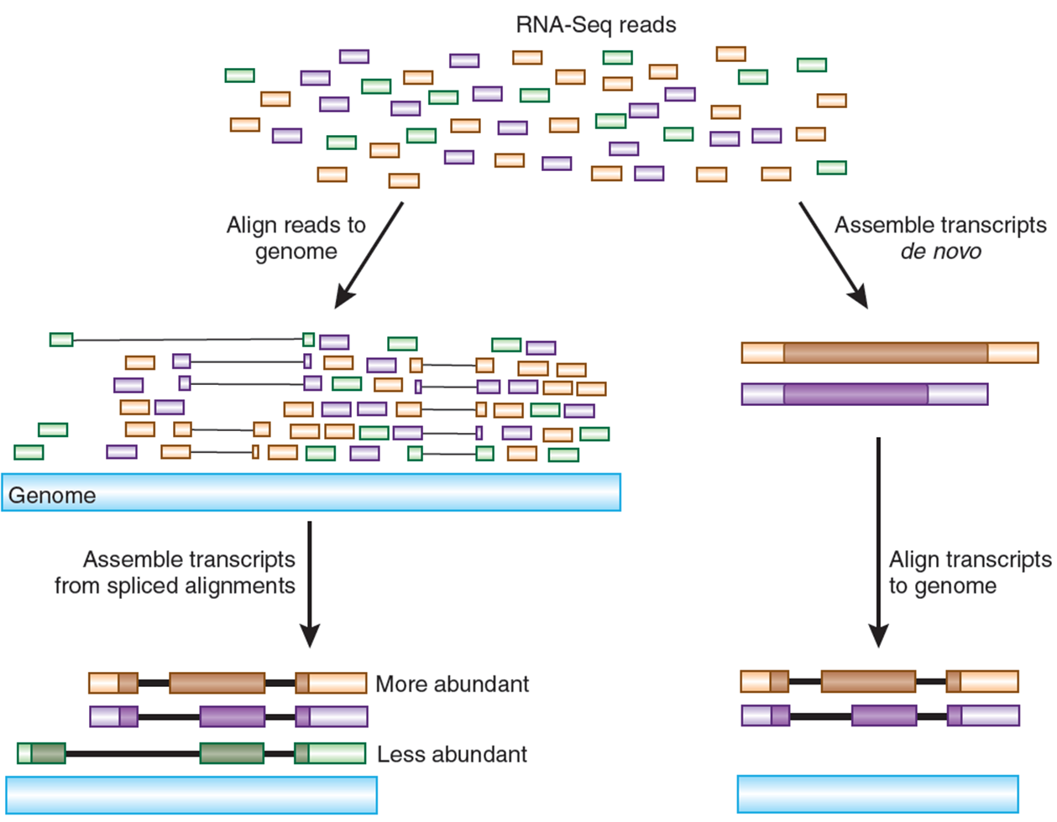
Transcriptome assembly
Stored in a
GFF/GTF file
Figure from: Haas, B. J. & Zody, M. C. Nature Biotech. 28, 421–423 (2010)

Slide 3
De novo transcript assembly
Similar to genome (contig) assembly
Obstacles:
  Highly uneven coverage of different transcripts and along a transcript
  Gaps in transcript coverage and repeats?
  We do not know where the splice sites are!
  Alternative splicing:
I do not recommend doing this unless there is no genome available

Slide 4
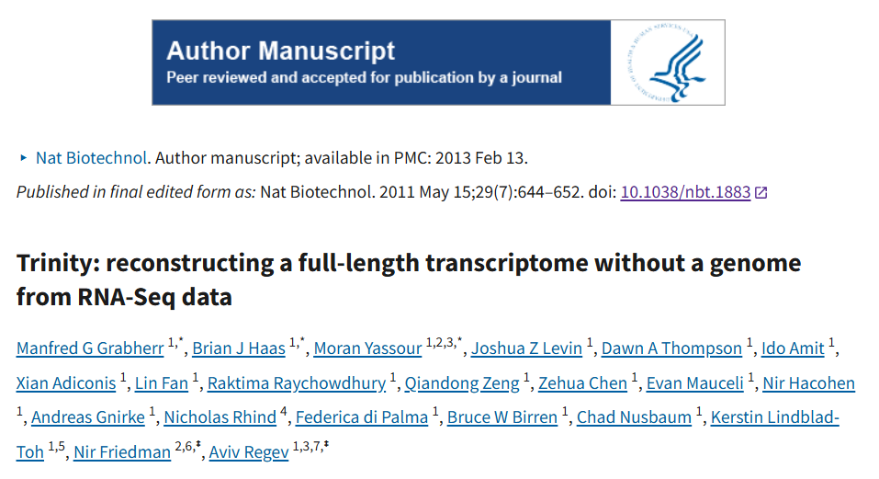
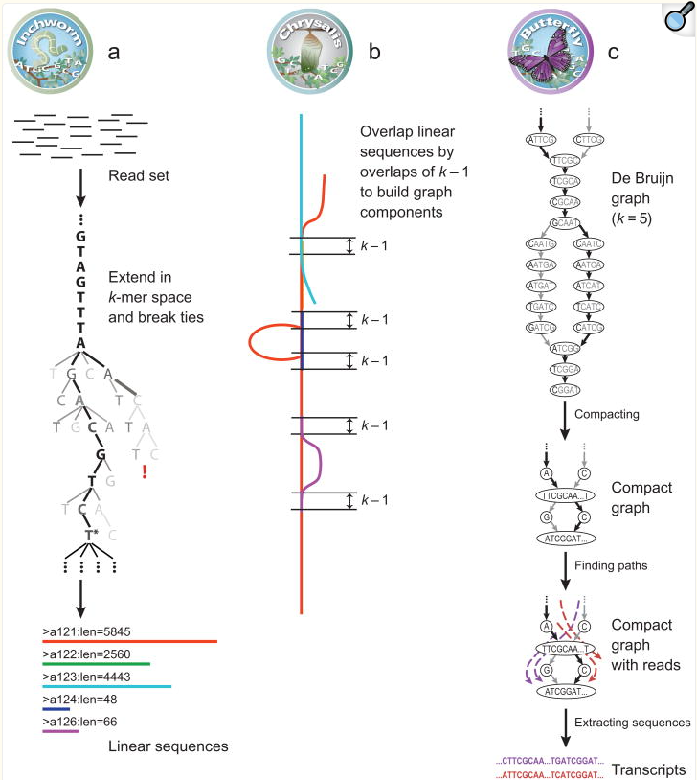
De novo transcript assemblers
Short-read: Trinity, based on DeBruijn graph

Slide 5
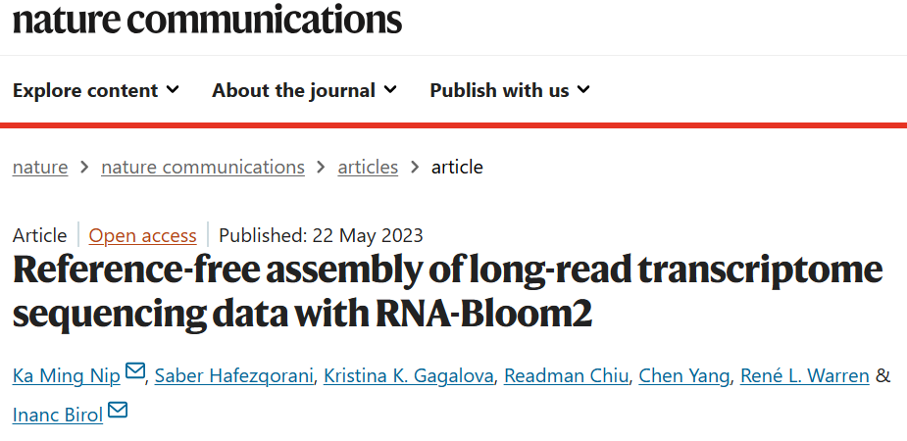
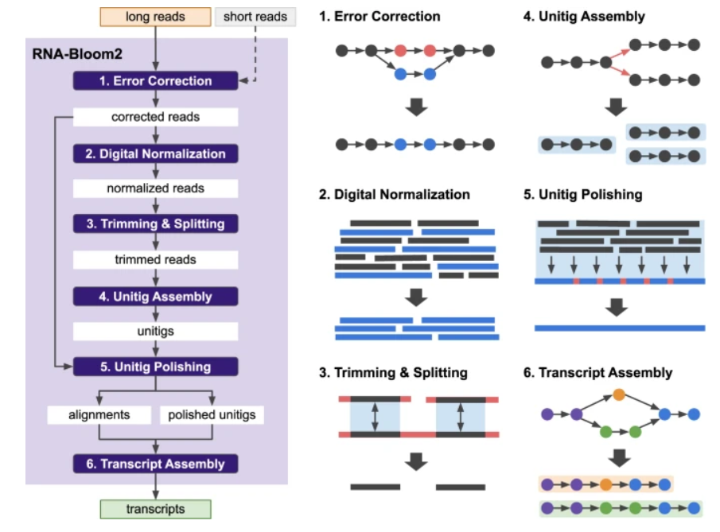
De novo transcript assemblers
Long read: RNA-Bloom2

Slide 6
Spliced alignment
We can (more reliably) find transcripts on the genome by spliced alignment of transcriptome reads
Spliced alignment is gapped alignment with specific sequence patterns around gaps
Transcriptome read
AAAAAAA
Forward or “+” strand alignment
Genome
GT AG
exon
exon
AAAAAAA
Reverse or “-” strand alignment
Genome
CT AC
exon
exon

Slide 7
Spliced alignment
We expect GT-AG (CT-AC) canonical splice sites
Other combinations are possible (GC-AG or AT-AC)
Un-spliced aligned reads – strand unknown
Transcriptome read
AAAAAAA
Forward or “+” strand alignment
Genome
GT AG
exon
exon
AAAAAAA
Reverse or “-” strand alignment
Genome
CT AC
exon
exon

Slide 8
Spliced alignment programs
Illumina RNA-seq reads
  STAR
  HISAT2
Long reads (PacBio or ONT):
  Minimap2
Spliced alignments sometimes produce errors/miss splice sites
  “anchors” may be short
    AGATAA|(GT)……………(AG)|GT or AGATAAGT ?
  Non-canonical splice sites can be off
Errors in Oxford Nanopore Technologies reads (especially indels) can lead to imprecise splice site detection

Slide 9
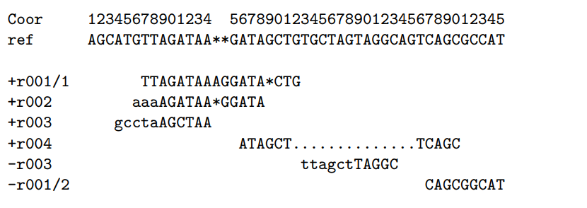
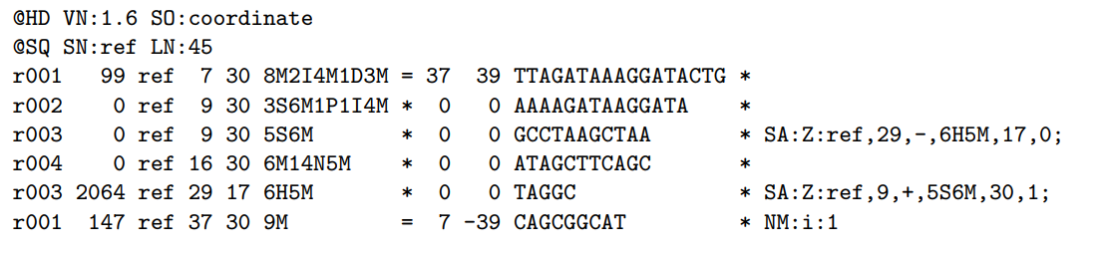
SAM format for spliced alignment
Examples of CIGAR strings

Slide 10
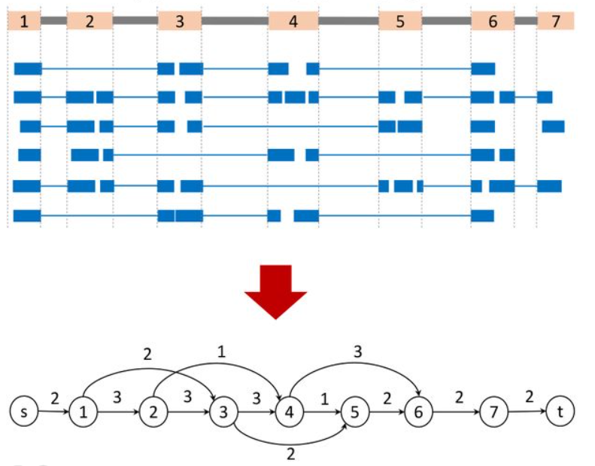
Assembly of aligned RNA-seq data
Image credit: https://www.biorxiv.org/content/10.1101/2024.02.09.579380v1.full
Use spliced alignments
Typically faster and more accurate
Build splice graph:
  Nodes are exons
  Edges are introns
  Edge weight is the number of spliced reads
Remember that these data represent several linear transcripts

